Slide 1
Conference Management System

Slide 2
Project Overview
To create a web-based Conference Management System for scientific conferences, facilitating paper submissions, review assignments, and decision-making.
Key Features:
View submissions of scientific papers with title, authors, keywords, abstract, and PDF attachment.
Assignment of papers to reviewers.
Automatic workload distribution for fair review assignments.
User Roles: Conference Organizers (Admins), Reviewers, Authors
Tasks:
Organizer signs in to view submitted papers and assign reviewers.
Organizer can view profile details of submitted author.
Organizer can view list of Reviewers and their profile details as well.
Organizer assigns papers to reviewers and view the assignments made.

Slide 3
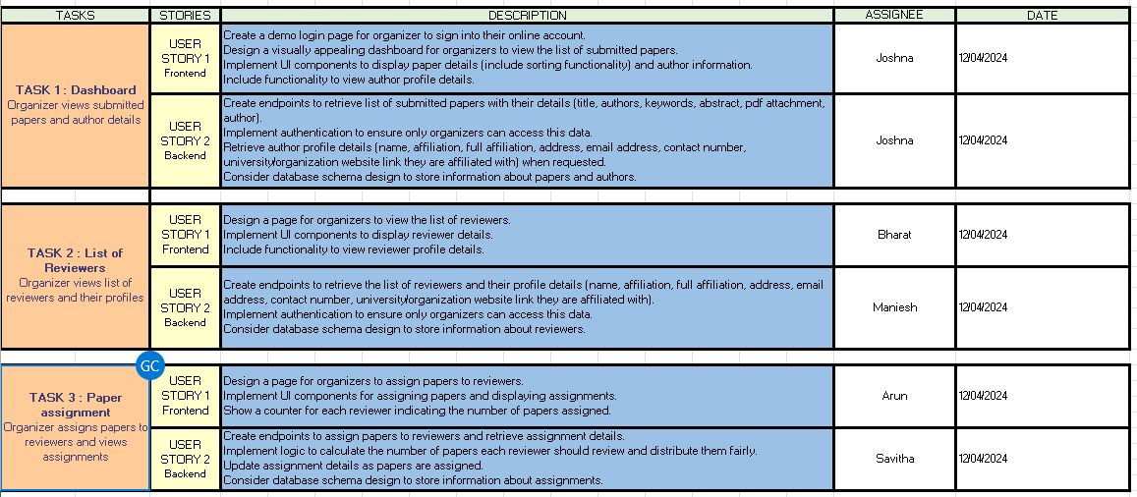
Agile Working Plan

Slide 4
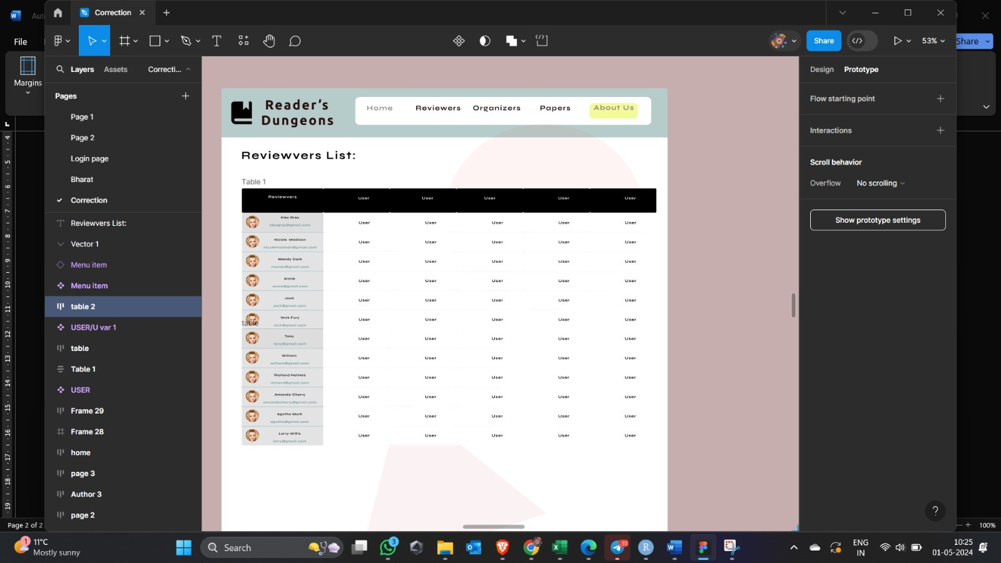
Wireframe

Slide 5
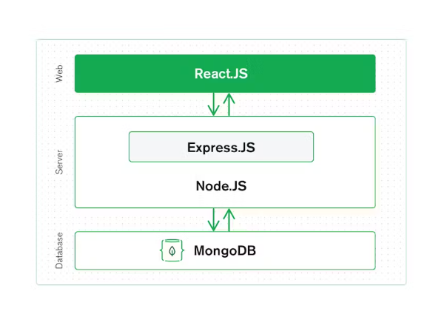
Tech Stack

Slide 6
Tech Stack
Backend
Node.js
Express.js
MongoDB
MongoDB Atlas
Mongoose
Frontend
React
Axios
CSS
HTML
Bootstrap
Others
Git
GitHub
Postman
VS Code
Browser Developer Tools

Slide 7
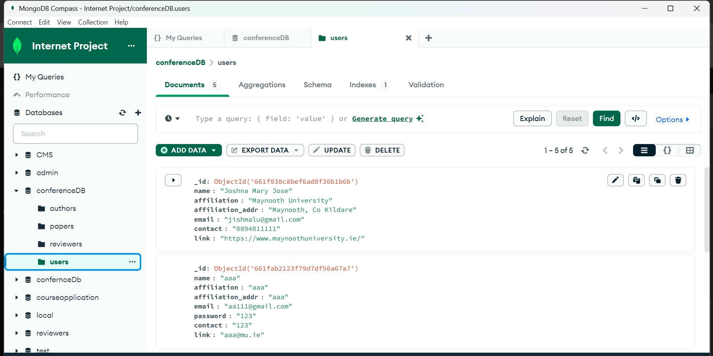
Database and Table Details

Slide 8
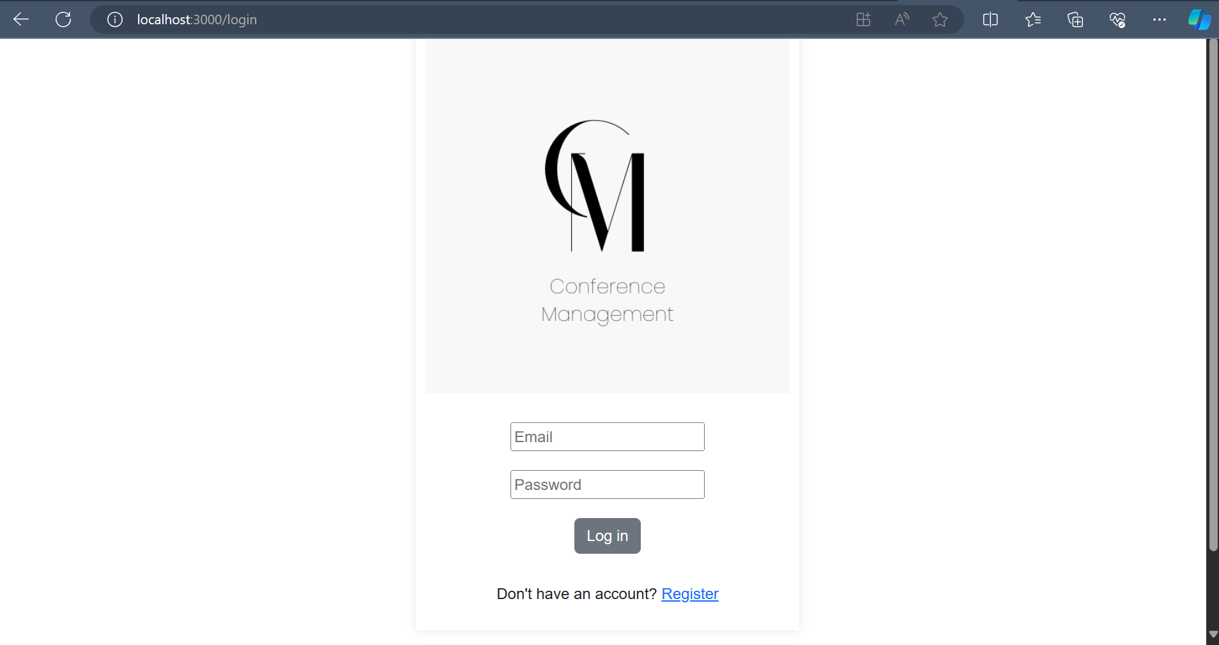
Login Page

Slide 9
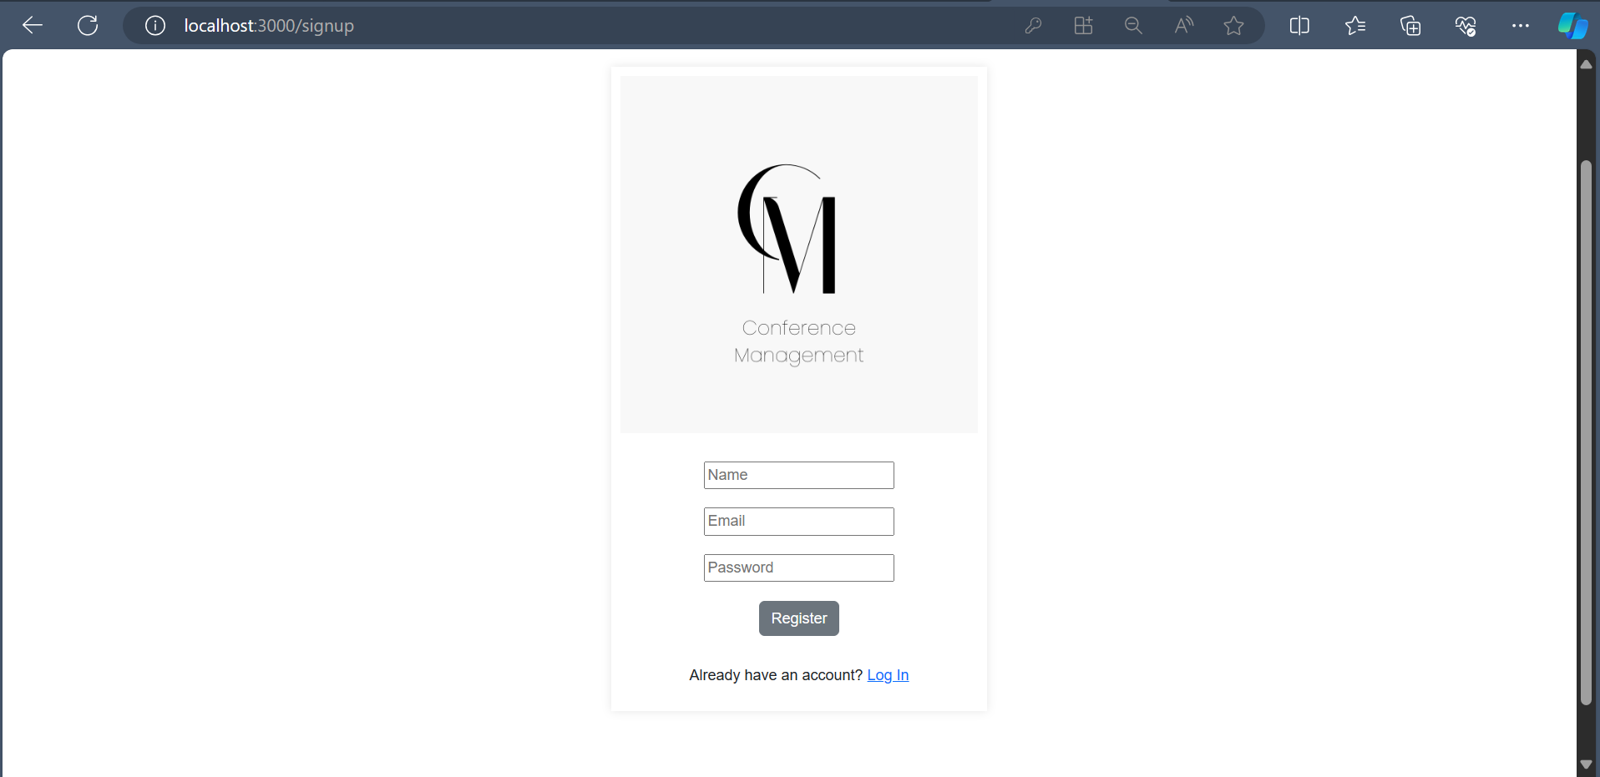
Sign Up Page

Slide 10
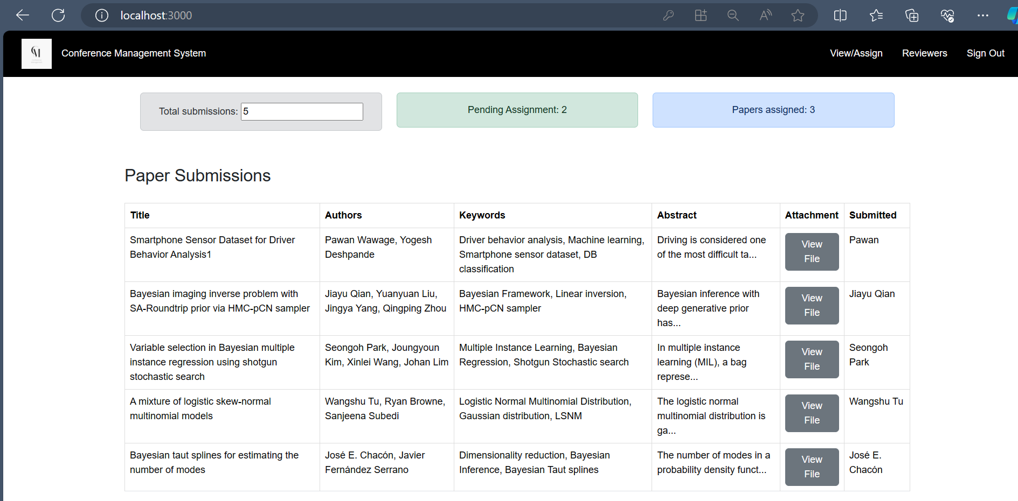
Dashboard
Organizer views submitted papers and author details

Slide 11
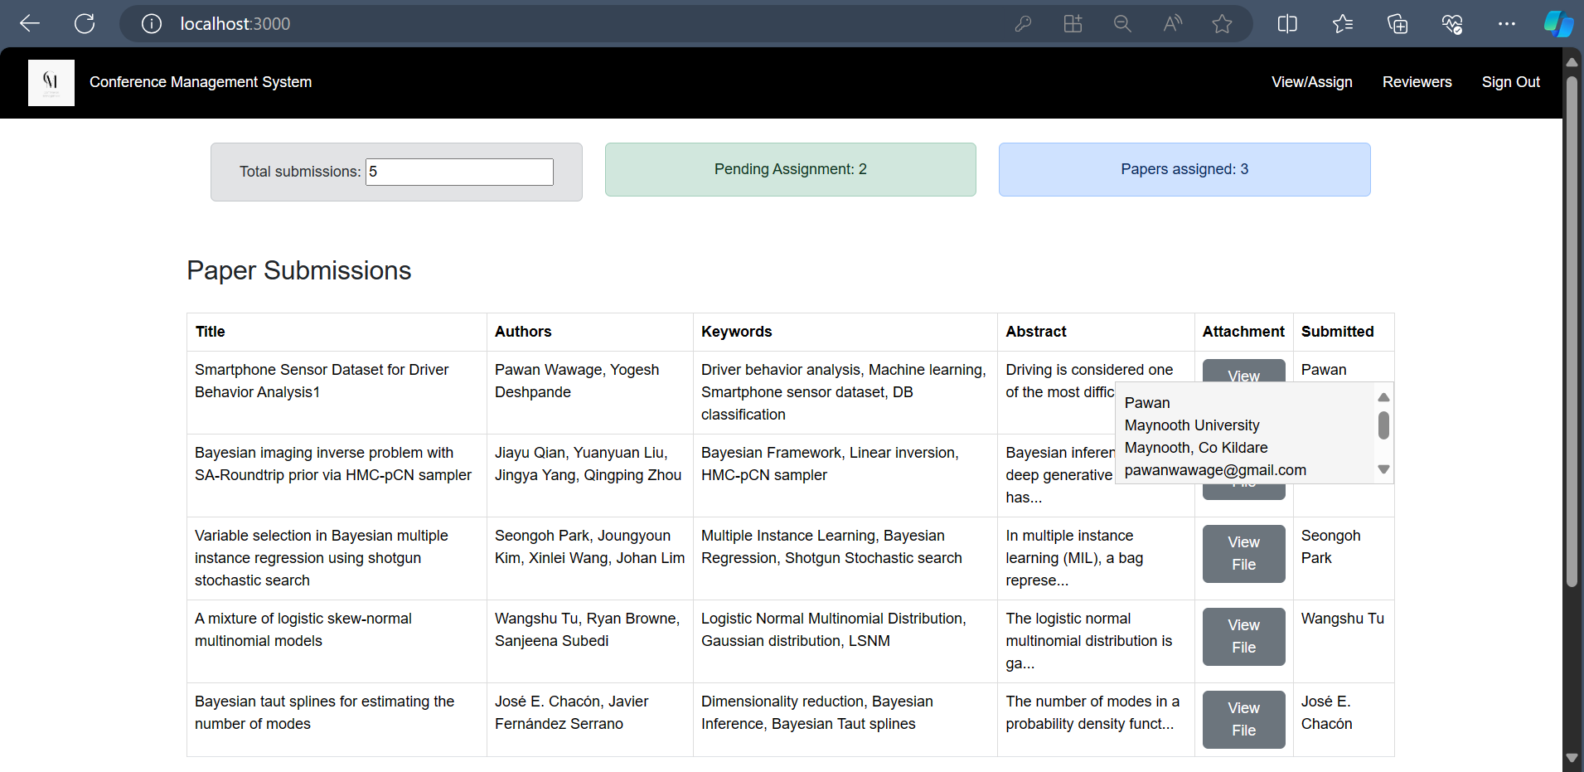
Dashboard
Organizer views submitted papers and author details
Author Details pop – up

Slide 12
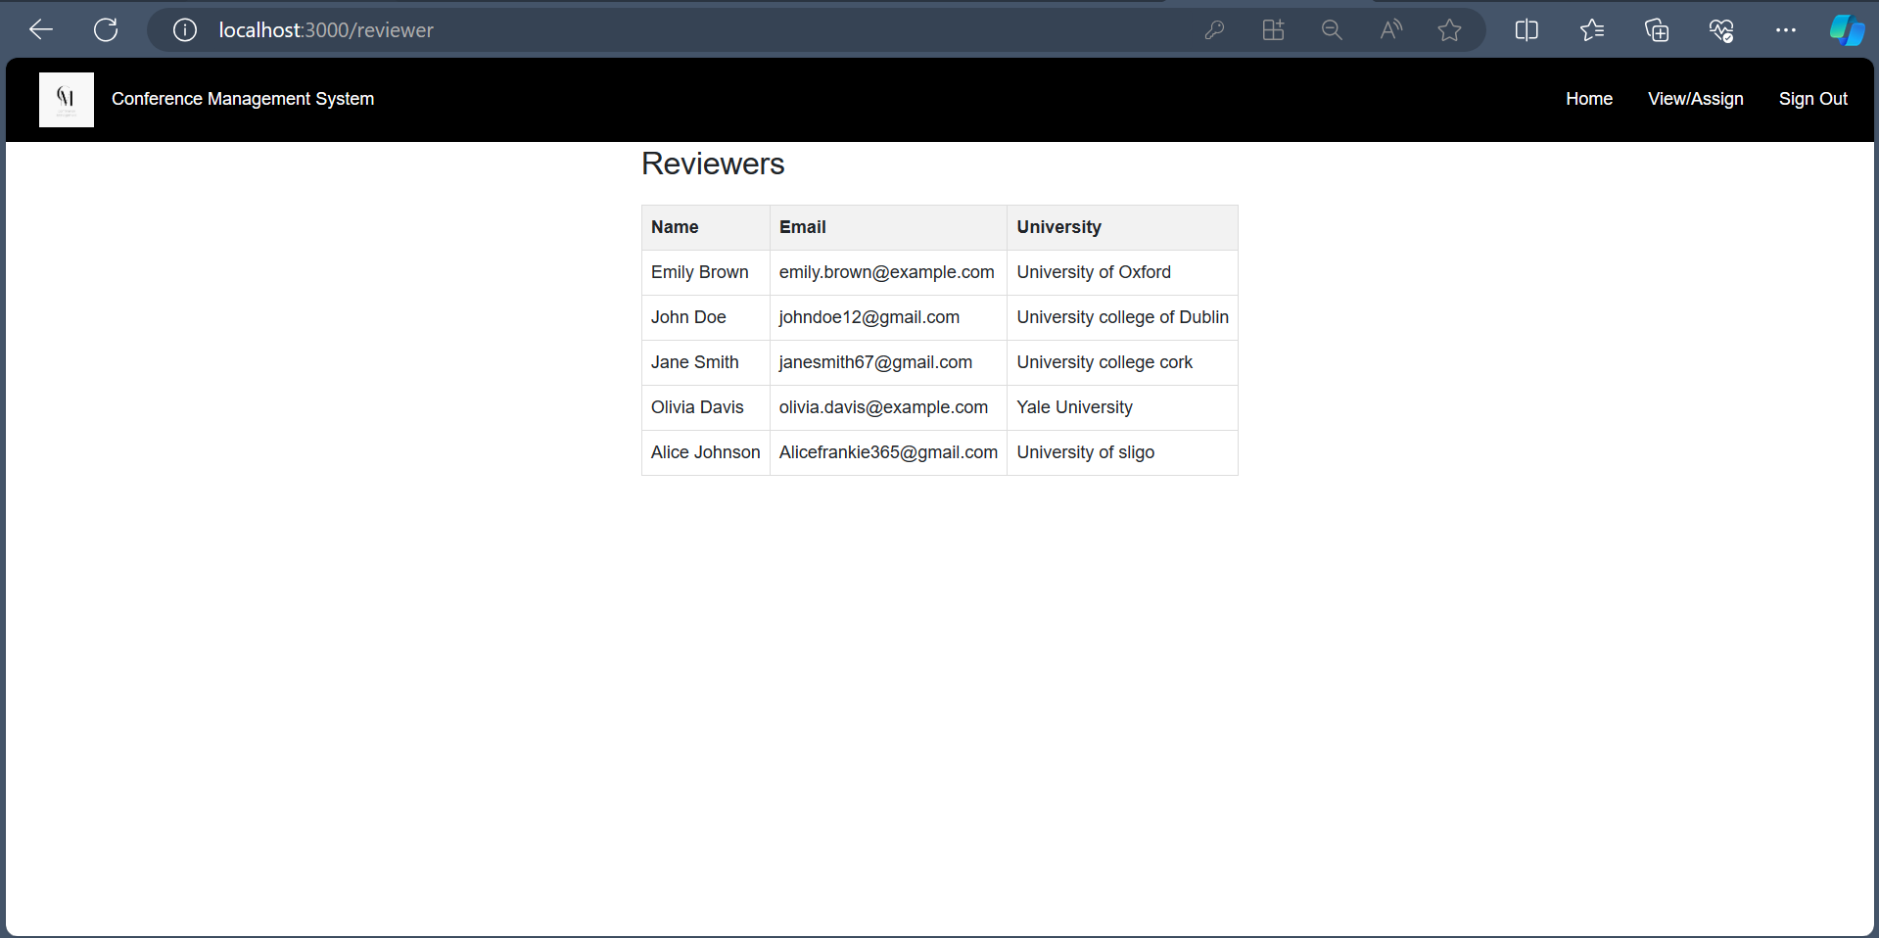
List of Reviewers
Organizer views list of reviewers and their profile

Slide 13
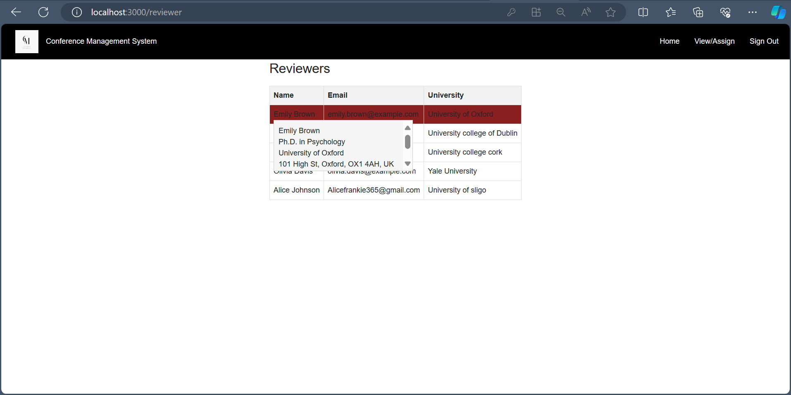
List of Reviewers
Organizer views list of reviewers and their profile
Reviewer Details pop - up

Slide 14
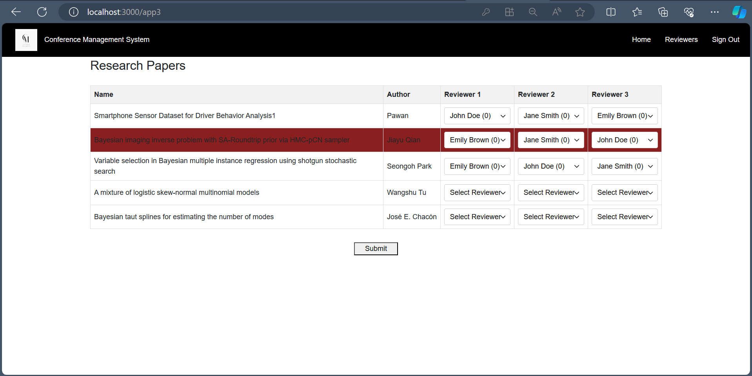
Paper Assignments
Organizer assigns papers to reviewers fairly

Slide 15
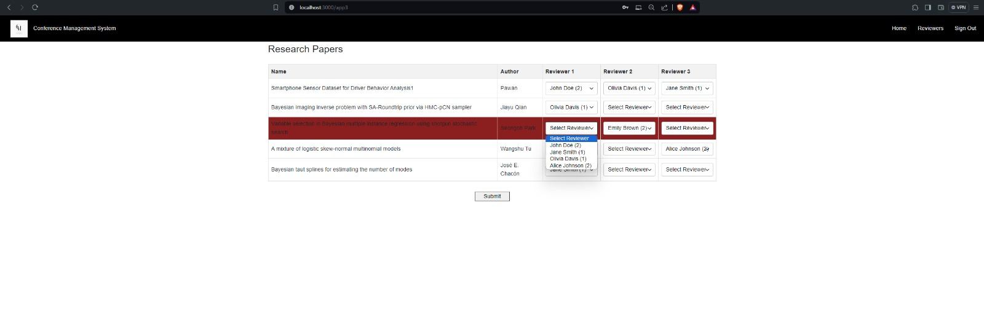
Paper Assignments
Organizer can assign unique reviewers for a paper

Slide 16
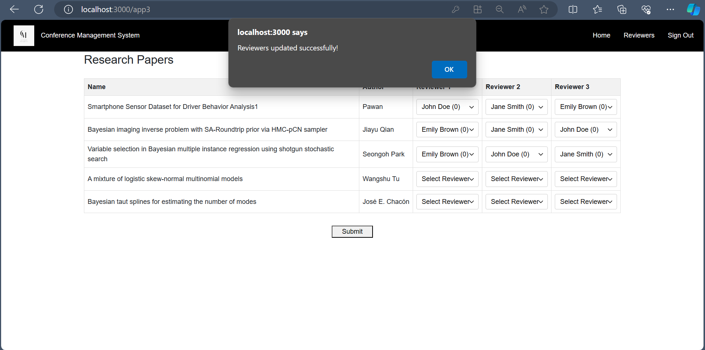
Paper Assignments
Organizers assign papers to reviewers

Slide 17
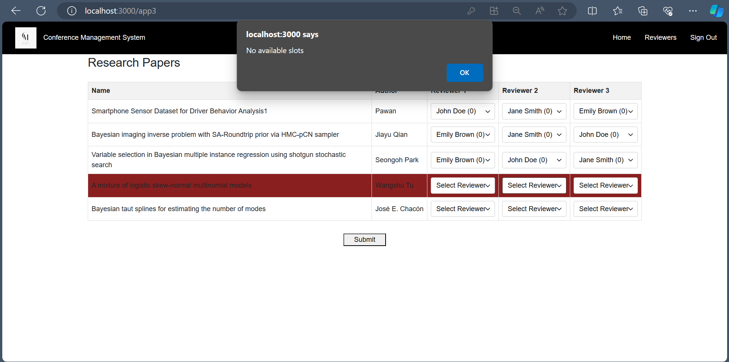
Paper Assignments
When the number of allocations for the selected reviewer is 0

Slide 18
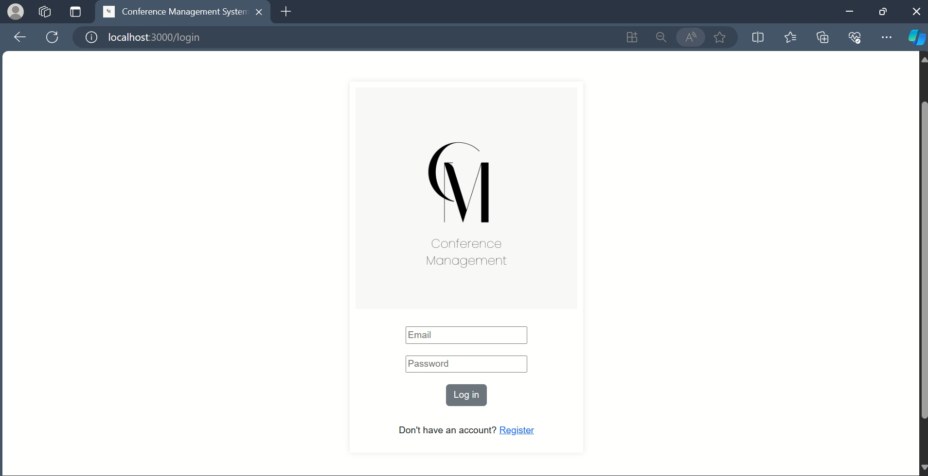
Demo

Slide 19
Conclusion
In conclusion, we have developed an application to streamline conference management processes. Our application offers the following features:
Paper Management: View submitted papers, their statuses, and author details.
Reviewer Management: Access the list of reviewers and their information.
Automated Reviewer Assignment: Assign reviewers to papers, ensuring an evenly distributed workload.
With these features, our application provides an efficient solution for organizing and managing conferences.

Slide 20
Thank You

